Slide 1
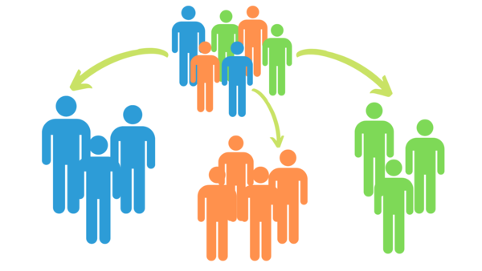
CREDIT CARD USERS SEGMENTATION
USING CLUSTERING TECHNIQUES
Presentation by: - Damini Thandele
Roll No.: - FS/MBA-BA/1807
Batch: - 2018-2020

Slide 2
Internship
CRG Solutions Pvt. Ltd. is a Business Performance Improvement company, helping organizations traverse their Data to Insights journey and beyond. It leverages curated Analytics Technology such as Tableau & Alteryx.
In my internship tenure I was thoroughly trained on the above mentioned tools and database theory.
Due to my willingness to work on an Advanced Analytics project I worked under my senior on one such project and helped prepare a POC using Python as the major tool.

Slide 3
Business Understanding
We make it possible for our customers to buy items on EMI instalments without credit cards from Amazon, Flipkart, and our other such partnered e-commerce companies. Shoppers buy mobiles, other electronics, appliances and various other items using our simple 5-minute online process.
Since we have a large customer database who shop through our virtual credit service, we are having difficulty to identify what our customers are like.
We are spending high on our email campaigns as there are a lot of deals and we cannot miss a potential customer. Can we optimize it?

Slide 4
Proposed Solution
Develop a customer segmentation model that will help you gain insights about your customer’s behaviour.
Segment customers on the basis of homogeneity of their characteristics which will help you optimize your email campaign and let you target the offers only to those customers who might be interested in them.

Slide 5

Credit Card
‘Plastic money’
An instrument that allows one to take credit/loan
Revolving line of credit
Generally used to make payments at outlets and online stores

Slide 6
Key Terminologies
Balance: - amount due to be paid based on purchases, interest charges, and any additional fees
Minimum Payment: - amount of payment required from the user to help avoid a ‘late payment fee’. Generally, about 5% of total amount of bill
Credit Limit: - maximum amount of credit that a credit card issuer extends to a user. It is decided based on your salary and CIBIL Score
Interest Free Period: - time period between the start of the billing cycle and the due date when no interest is charged on non-repayment. Generally, 50 days long.

Slide 7
Why Customer Segmentation?
Customer Retention: - “It’s cheaper to hang on to a current customer than it is to bring in a new one.”
One-size-fits-all approach doesn’t work so they must follow a personalized approach.
Customer segmentation makes marketing cost-effective by targeting relevant audience.
Highly predictable customer groups make it easier to forecast card profitability.

Slide 8
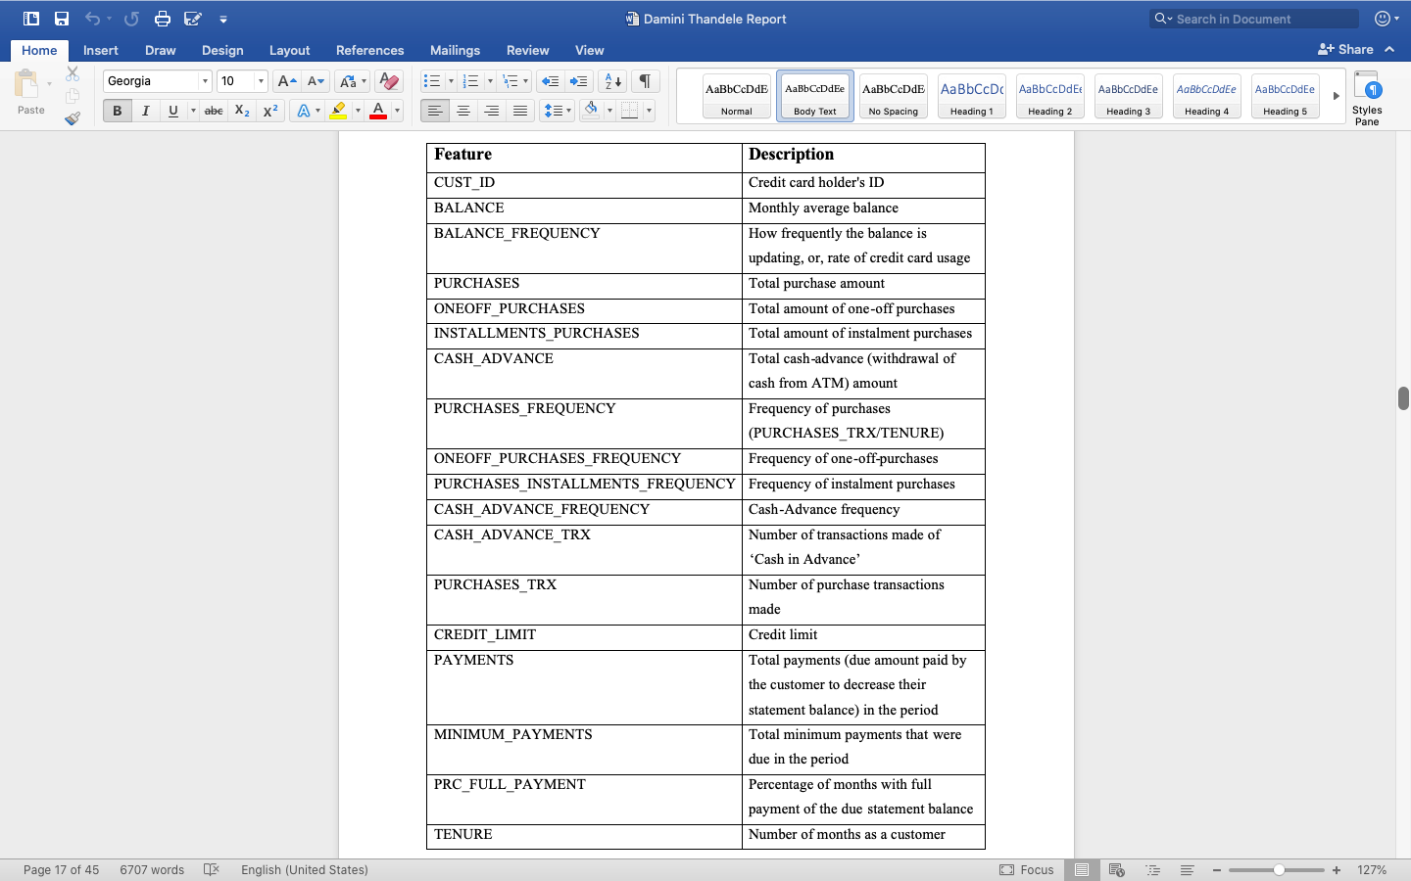
Data Dictionary
There are a total of 8950 observations and 18 variables in the data. Let’s explore the variables.

Slide 9
Data Dictionary (Cont.)

Slide 10
Feature Engineering
Monthly Average Purchase & Monthly Average Cash Advance Amount
1. Monthly Average Purchase = Purchases/Tenure
Average Amount Per Purchase & Average Amount Per Cash Advance Transaction
3. Average Amount per Purchase = Purchases/No. of Transactions
4. Average Amount per Cash Advance = Cash Advance/No. of Transactions
2. Monthly Average Cash Advance = Cash Advance/Tenure

Slide 11
Feature Engineering (Cont.)
Credit Utilization Ratio or Limit Usage
How much debt a user is carrying
5. Credit Utilization Ratio = Balance/Credit Limit
Payments to Minimum Payments Ratio
How much more than the minimum payment a user is paying
6. Payments to Minimum Payments Ratio = Payment/Minimum Payments
Purchase Type
7. Categorical variable: - One-off, Instalment, Both or None Purchase Type

Slide 12
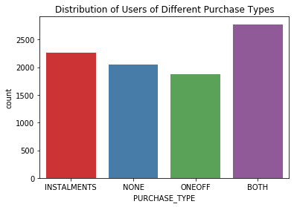
Key Insights Using Purchase Type
Majority of credit card users prefer to make purchases in both one-off and installment payments.

Slide 13
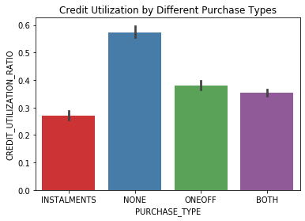
Key Insights Using Purchase Type (Cont.)
Users that have only used their credit cards to make cash advance transactions used their credit limit the most.

Slide 14
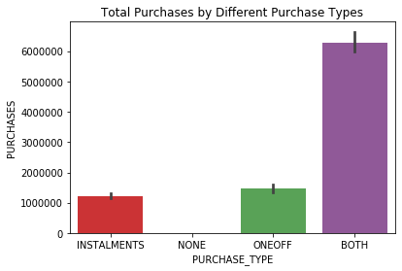
Key Insights Using Purchase Type (Cont.)
Most active credit card users are those that make use of both – one off and installments payments services.

Slide 15
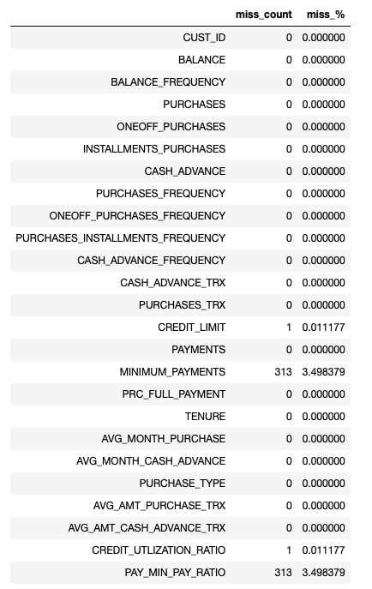
Missing Data
Only 4 columns have missing values and they form less than 30% of the total values present in the column.
Therefore, we can impute them (against dropping the entire column).

Slide 16
Imputation
For the purpose of imputation, we’ll follow a 4-step procedure, which is as follows.
STEP 1 - We will delete some known values from the dataframe
STEP 2 - Then we will use different imputing techniques
STEP 3 - We will compare all imputation results of different techniques with the actual values
STEP 4 - We will choose the imputation technique whose results are closer to the actual values

Slide 17
Imputation (Cont.)
Since the mean is not robust to outliers, it did not generate good results for imputation.
Even the median did not perform well due to the high variance in the data.
KNN Imputation - Since KNN algorithm uses mean value for estimation, it is highly sensitive to outliers, hence outliers must be removed. Also, since it’s a distance-based algorithm, feature-scaling is required.

Slide 18
Removing Outliers
IQR = Q3 – Q1
lower outer fence = Q1 - 3*IQR
upper outer fence = Q3 + 3*IQR
After removing the outliers, the dataset was reduced to 4426 observations.

Slide 19
Feature Scaling
Feature scaling is generally performed using the two of below mentioned methods: -
Standardization
Centres the data around mean with unit standard deviation.
More suitable when the distribution of the data is normal.
$$x^{′}=\frac{x − μ}{σ}$$
𝑥^′=(𝑥 − 𝜇)/𝜎
Normalization
Shifts the data and rescales it in the specified range usually [-1, 1] or [0, 1].
More suitable when the distribution of the data is not normal.
$$v_{i}^{′}= \frac{v_{i} − \min_{A}}{\max_{A} − \min_{A}} \left({new_max}_{A} − {new_min}_{A}\right)+ {new_min}_{A}$$
𝑣_𝑖^′= (𝑣_𝑖 − 〖𝑚𝑖𝑛〗_𝐴)/(〖𝑚𝑎𝑥〗_𝐴 − 〖𝑚𝑖𝑛〗_𝐴 ) (〖𝑛𝑒𝑤_𝑚𝑎𝑥〗_𝐴 − 〖𝑛𝑒𝑤_𝑚𝑖𝑛〗_𝐴 )+ 〖𝑛𝑒𝑤_𝑚𝑖𝑛〗_𝐴

Slide 20
Normality Test
Since, the size of the data is greater than 2000, we’ll use the non-parametric Jarque-Bera test to test normality of the variables.
The test matches the skewness and kurtosis of data to see if it matches a normal distribution. A normal distribution has a skew of zero (i.e. it’s perfectly symmetrical around the mean) and a kurtosis of three.
H₀: the data is normally distributed.
H_{a}: the data does not come from a normal distribution.

Slide 21
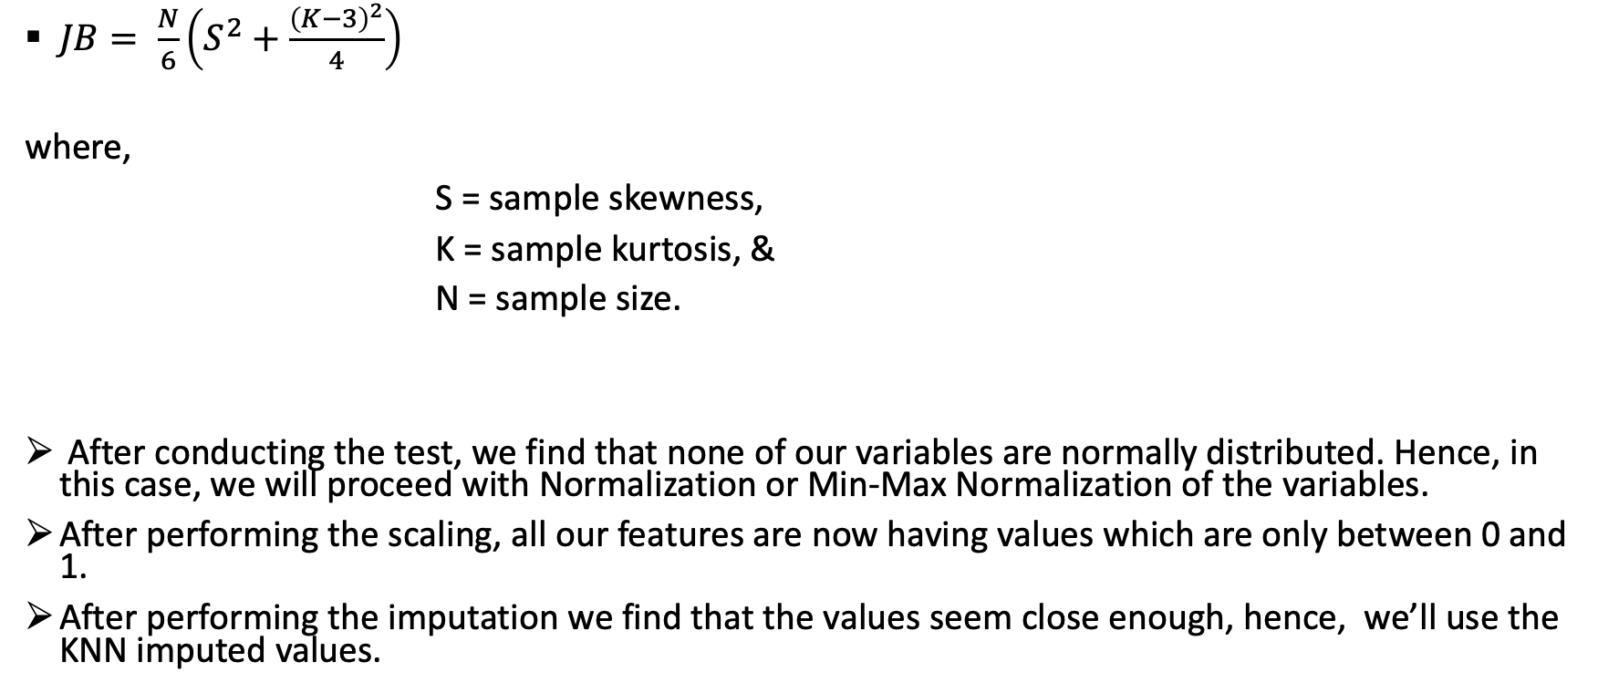
Normality Test (Cont.)
$JB= \frac{N}{6}\left(S^{2}+\frac{{\left(K−3\right)}^{2}}{4}\right)$
where,
S = sample skewness,
K = sample kurtosis, &
N = sample size.
After conducting the test, we find that none of our variables are normally distributed. Hence, in this case, we will proceed with Normalization or Min-Max Normalization of the variables.
After performing the scaling, all our features are now having values which are only between 0 and 1.
After performing the imputation we find that the values seem close enough, hence, we’ll use the KNN imputed values.

Slide 22
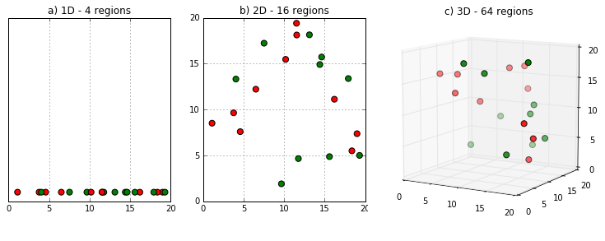
Feature Extraction
As the number of features or dimensions grow, the amount of data we need to generalize (more the redundancy,
better the generalization) accurately grows exponentially.
Observed features or observed dimensionality obscure the true or intrinsic dimensionality of the data.
Exponential growth in dimension space causes high sparsity in the data set and unnecessarily increases storage
space and processing time for the particular modelling algorithm.

Slide 23
Principal Component Analysis
Principal Component Analysis is a dimensionality reduction method that performs feature extraction by constructing a new set of dimensions which are linear combinations of the original.
Original dimensions: X₁ X₂ X₃ …. X_{d}
New dimensions: E₁ E₂ E₃ …. E_{m} = f (X₁ X₂ X₃ …. X_{d})
1st PC: in the direction of the greatest variability in the data
2nd PC: perpendicular to 1st, greatest variability of what’s left, and so on

Slide 24
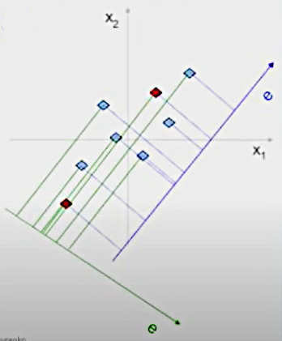
Variability
The PCs must preserve as much ‘structure’ in the data as possible.
The line that explains the most variability, most preserves the distance between data points, which is important especially when working with distance-based algorithms.

Slide 25
PCA Algebra
1. Centre the data: - Subtract mean value from each variable.
X_{i, a} = X_{i, a} - ∏_{a}
Where,
i: i^{th} observation
a: a^{th} feature
∏_{a}: Mean of a^{th} feature

Slide 26
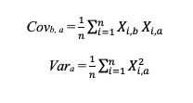
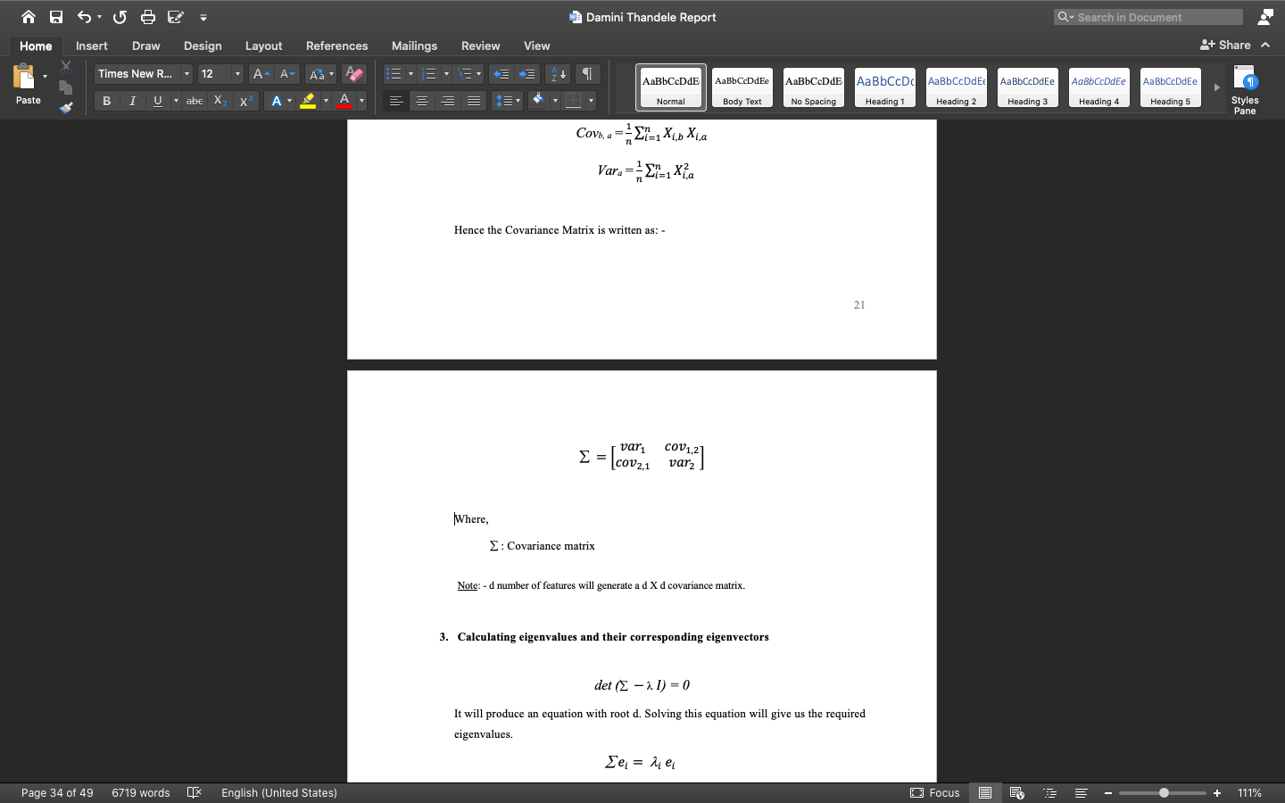

PCA Algebra (Cont.)
2. Compute covariance matrix: - d number of features will generate a d X d covariance matrix having variance of each attribute in the diagonal elements.
Hence, the covariance matrix is written as: -
Where,
$$: Covariance matrix

Slide 27
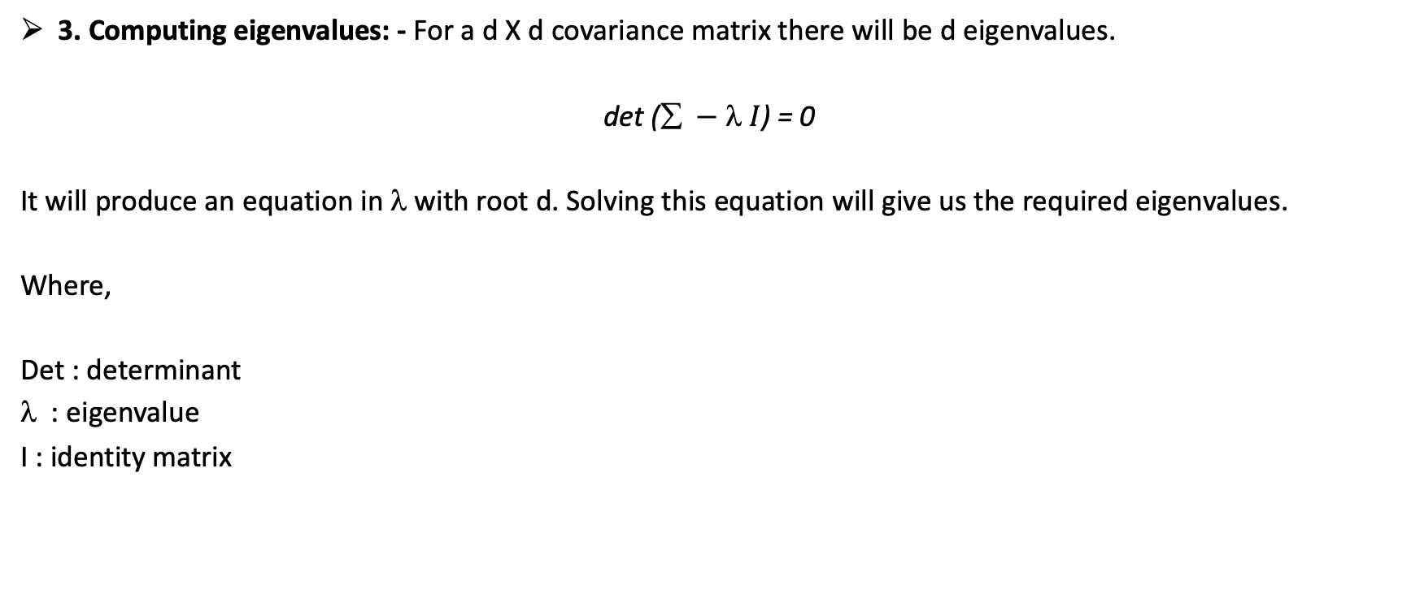
PCA Algebra (Cont.)
3. Computing eigenvalues: - For a d X d covariance matrix there will be d eigenvalues.
det ($ − I$) = 0
It will produce an equation in λ with root d. Solving this equation will give us the required eigenvalues.
Where,
Det : determinant
: eigenvalue
I : identity matrix

Slide 28
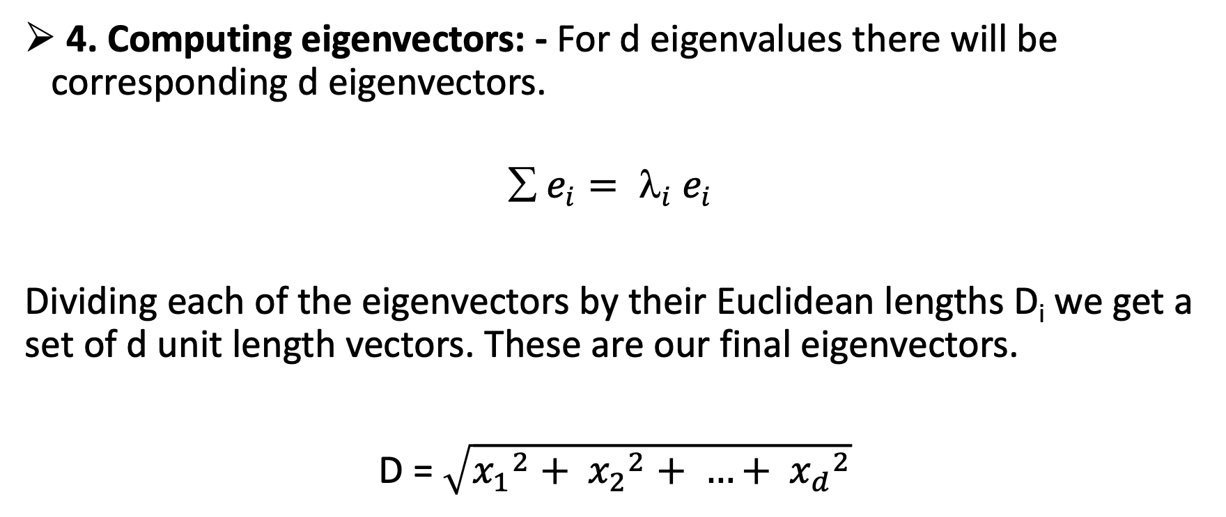
PCA Algebra (Cont.)
4. Computing eigenvectors: - For d eigenvalues there will be corresponding d eigenvectors.
$$ e_{i}= _{i} e_{i}$$
Dividing each of the eigenvectors by their Euclidean lengths D_{i} we get a set of d unit length vectors. These are our final eigenvectors.
D = $\sqrt{{x_{1}}^{2}+ {x_{2}}^{2}+ …+ {x_{d}}^{2}}$

Slide 29
PCA Algebra (Cont.)
5. Project the data points in the new dimensional space: -
Original coordinates of data point: X = {X₁ X₂ X₃ …. X_{d}}
New coordinates of data point: X’ = {X’₁ X’₂ X’₃ …. X’_{d}}
X’_{i} = (X_{i} - ∏_{i})^{T}e_{i}
NOTE: - The new dataset now consists of a total of 27 features: - the original 17 numeric variables (all except customer ID), the 6 newly added numeric variables and 4 dummy variables derived from ‘Purchase Type’ (i.e., ONEOFF, INSTALMENT, BOTH and NONE).

Slide 30
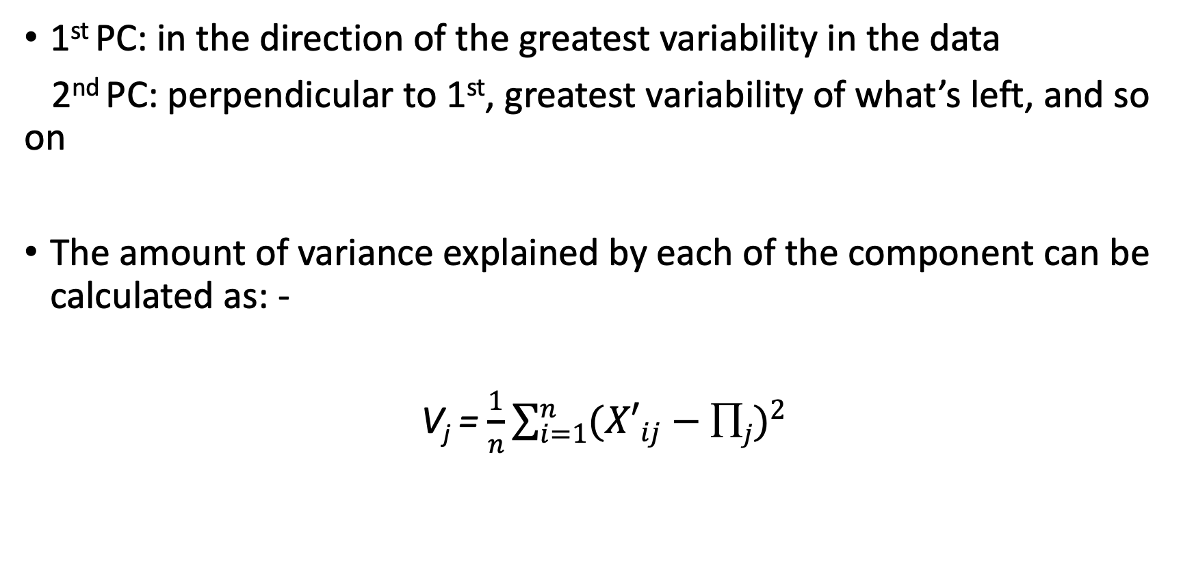
Optimal Number of Components
1st PC: in the direction of the greatest variability in the data
2nd PC: perpendicular to 1st, greatest variability of what’s left, and so on
The amount of variance explained by each of the component can be calculated as: -
V_{j} = $\frac{1}{n}\sum_{i=1}^{n}{{({X′}_{ij}−∏j)}^{2}}$

Slide 31
Optimal Number of Components (Cont.)
Scree Plot: - A scree plot shows how much variation each PC captures from the data. The y axis is the amount of variation explained by principal component. An ideal curve should be steep, then bends at an “elbow” — this is the cutting-off point — and after that flattens out. These are the number of components that are sufficient to significantly describe the data.

Slide 32
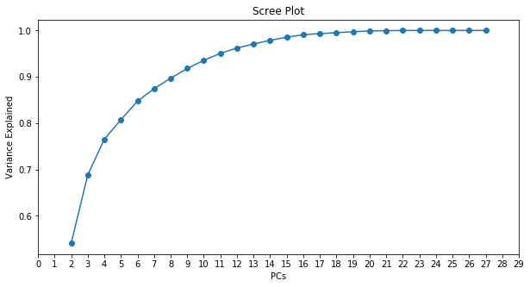
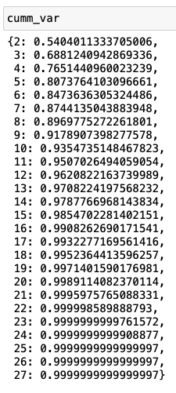
Optimal Number of Components (Cont.)
From the above images it is clear that 13 is the optimal no. of components which explain around 97% variance
In the data. Hence, we were able to effectively halve the feature set.

Slide 33
Applying Clustering Algorithms
Clustering is an unsupervised learning algorithm which is used to group similar observations together in order to find meaningful structure and groupings present in the set of observations.
For the purpose of the project I have used three different clustering algorithms, which are –
K-means
K-medoids
DBSCAN
After comparing them we’ll choose the best one to perform the desired groupings. Let’s see them one by one.

Slide 34
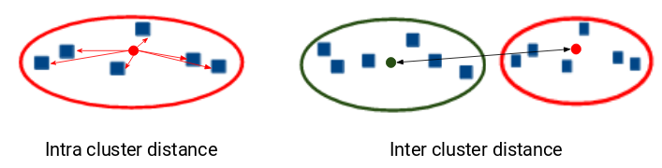
Optimal Number of Clusters
The optimal choice of k will strike a balance between maximum compression of the data using a single cluster, and maximum accuracy by assigning each data point to its own cluster.
That is, we need to minimize the intra-cluster distance and
maximize the inter-cluster distance.

Slide 35

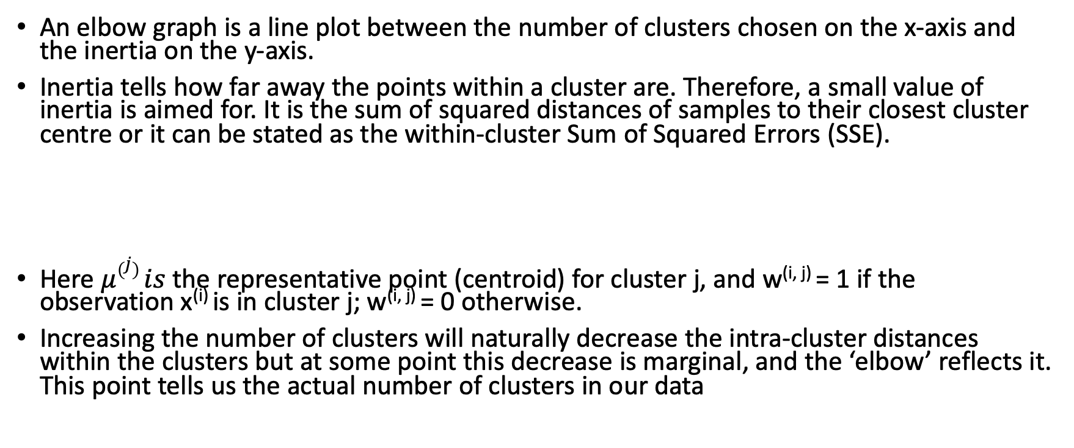
Elbow Method
An elbow graph is a line plot between the number of clusters chosen on the x-axis and the inertia on the y-axis.
Inertia tells how far away the points within a cluster are. Therefore, a small value of inertia is aimed for. It is the sum of squared distances of samples to their closest cluster centre or it can be stated as the within-cluster Sum of Squared Errors (SSE).
Here $μ\left(j\right) is$ the representative point (centroid) for cluster j, and w^{(i, j)} = 1 if the observation x^{(i)} is in cluster j; w^{(i, j)} = 0 otherwise.
Increasing the number of clusters will naturally decrease the intra-cluster distances within the clusters but at some point this decrease is marginal, and the ‘elbow’ reflects it. This point tells us the actual number of clusters in our data

Slide 36
K-means
K-means clustering is one of the simplest and most commonly used clustering algorithms.
STEP 1: Initialization: - choose K data points from the dataset as initial centroids and that’s simply because it does not know yet where the center of each cluster is.
STEP 2: Cluster assignment: - assign data points to the closest centroid.
STEP 3: Move the centroid: - A centroid’s new value is going to be the mean of all the examples in a cluster.
STEP 4: Stop: - The algorithm is finished on convergence (no change in centroid value) when the assignment of instances to clusters no longer changes.

Slide 37
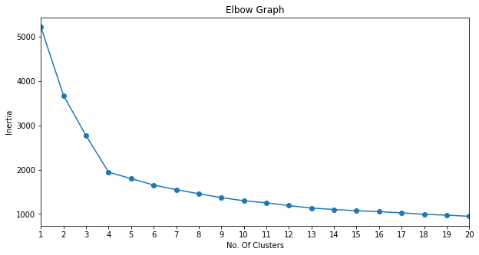
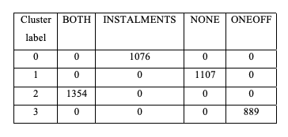
K-means (Cont.)
From the above graph, we can see that the optimum
number of clusters is 4.
Crosstab consisting of Cluster Labels and Purchase
Type

Slide 38
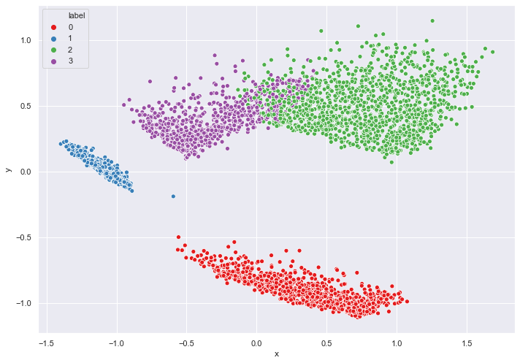
K-means (Cont.)
2D visualization of the clusters taking only the first 2 principal components: -

Slide 39
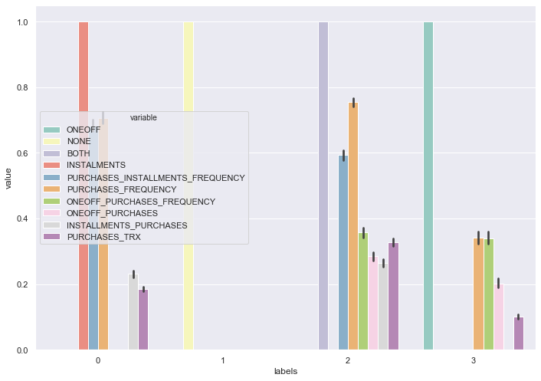
K-means (Cont.)
Top 10 variables that have the highest inter-cluster variance in their mean values: -

Slide 40
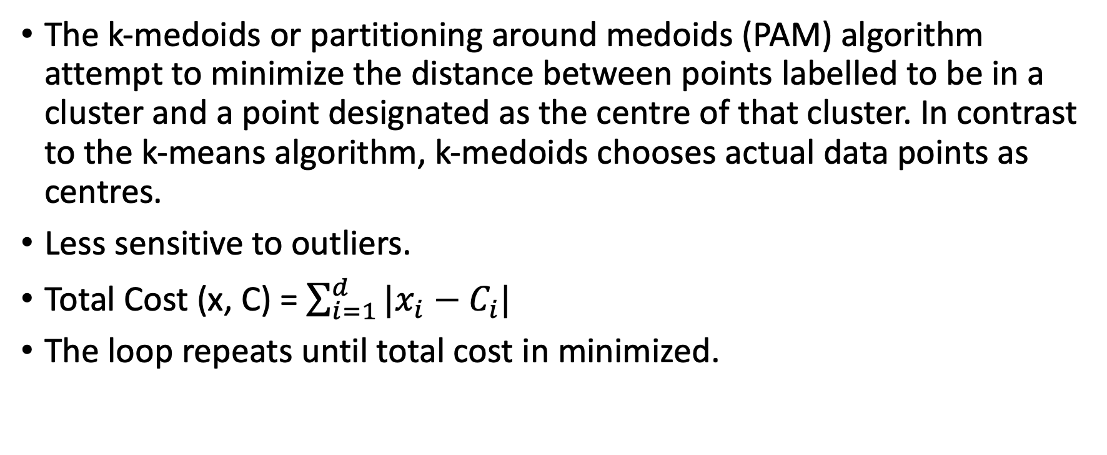
K-medoids
The k-medoids or partitioning around medoids (PAM) algorithm attempt to minimize the distance between points labelled to be in a cluster and a point designated as the centre of that cluster. In contrast to the k-means algorithm, k-medoids chooses actual data points as centres.
Less sensitive to outliers.
Total Cost (x, C) = $\sum_{i=1}^{d}{|x_{i}−C_{i}|}$
The loop repeats until total cost in minimized.

Slide 41
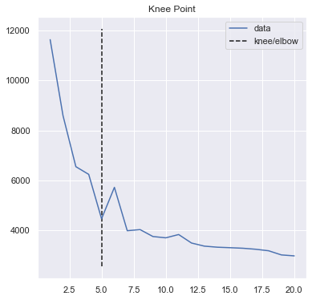
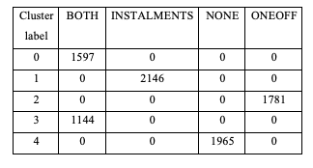
K-medoids (Cont.)
From the above graph, we can see that the optimum
number of clusters is 5.
Crosstab consisting of Cluster Labels and Purchase
Type

Slide 42
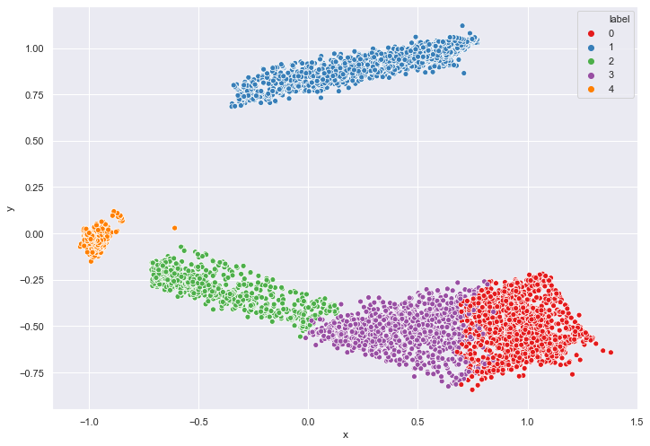
K-medoids (Cont.)
2D visualization of the clusters taking only the first 2 principal components: -

Slide 43
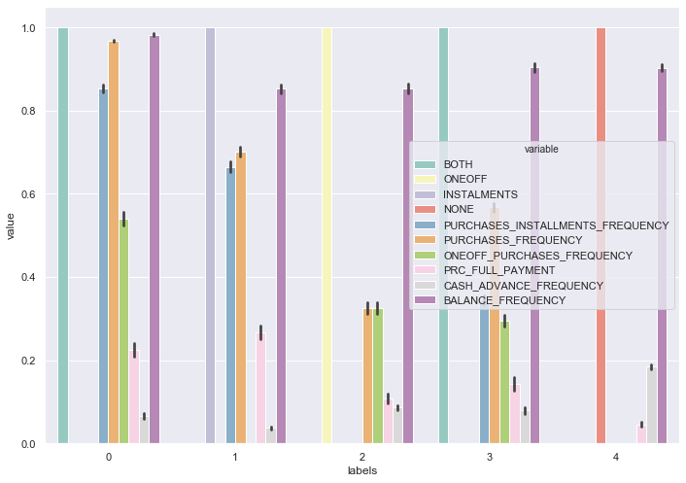
K-medoids (Cont.)
Top 10 variables that have the highest inter-cluster variance in their mean values: -

Slide 44
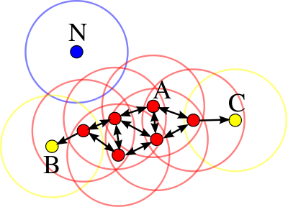
DBSCAN
Density-based Spatial Clustering of Applications with Noise
It uses two parameters – Min Points and eps to divide data points into three categories.
Min Points: - number of minimum points (including the point itself) that a data point need in its surrounding area (or neighbourhood) for it to be classified as a core point.
Eps: - Eps is the length of the radius drawn by taking the data point as the centre. The points that fall in this area are the neighbour points.
A point which is neither a core point nor a neighbour point is classified as an outlier.
Data Point
Core Point
Neighbour
Outlier

Slide 45
DBSCAN (Cont.)
Parameter Tuning
Min Points: - As a rule of thumb, min Pts = 2·dim can be used. Since we have 10 PCs, our Min Points will be 20.
Eps: - If the eps value chosen is too small it’ll result in many outliers while a large value will result in the merging of all of the clusters.
K-distance Plot: - It is used to determine the eps value by plotting the distances, from largest to the smallest value, of each of the data points to their (MinPoints-1)^{th} neighbour. Good value of ε is where this plot shows an "elbow".

Slide 46
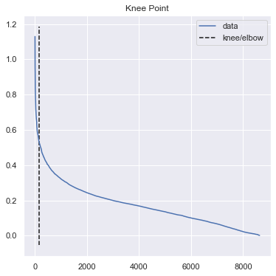
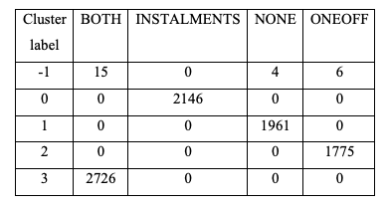
DBSCAN (Cont.)
Crosstab consisting of Cluster Labels and Purchase
Type
The elbow point lies at eps = 0.5257.

Slide 47
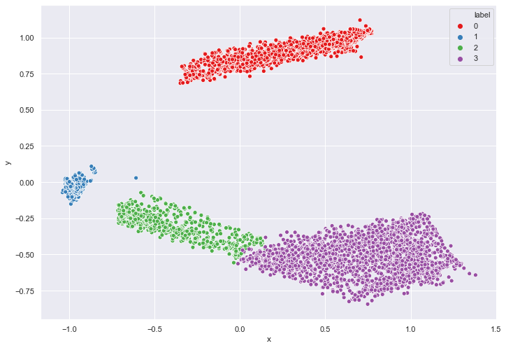
DBSCAN (Cont.)
2D visualization of the clusters taking only the first 2 principal components: -

Slide 48
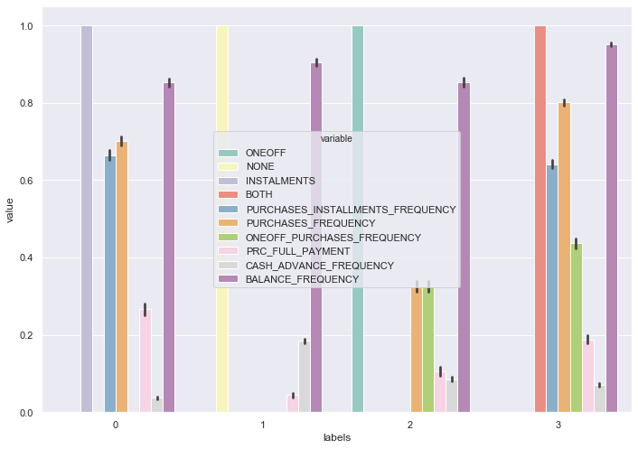
DBSCAN (Cont.)
Top 10 variables that have the highest inter-cluster variance in their mean values: -

Slide 49
CONCLUSION
Each algorithm has its benefits and drawbacks, hence it’s hard to choose which one to use
Need for an objective analysis arises
Silhouette Coefficient: - it’s a metric used to measure the performance of clustering algorithm.
computes the compactness of the cluster
measure of how similar an object is to its own cluster (cohesion) compared to other clusters (separation).
ranges from −1 to +1, where a high value indicates that the object is well matched to its own cluster and poorly matched to neighbouring clusters

Slide 50
CONCLUSION (Cont.)
Silhouette Coefficient = (x-y)/ max(x, y)
Y: mean intra cluster distance
X: mean nearest cluster distance
We calculate the silhouette coefficient for each sample or observation in the dataset and finally, compute its mean.
In order for the silhouette coefficient to be closer to 1, x, or the mean inter-cluster distance, must be greater than y, the intra-cluster distance.

Slide 51

CONCLUSION (Cont.)
Since, DBSCAN has the greatest value of the silhouette coefficient, it is the one that we will choose for deployment.
The outputs of this algorithm are our final results.

Slide 52
References
DBSCAN. (n.d.). Retrieved from wikipedia.org/: https://en.wikipedia.org/wiki/DBSCAN#Parameter_estimation
Wikipedia. (2020). DBSCAN. Retrieved from wikipedia: https://en.wikipedia.org/wiki/DBSCAN#Parameter_estimation
Dubey, A. (2018, 12 21). The Mathematics Behind Principal Component Analysis. Retrieved from towardsdatascience: https://towardsdatascience.com/the-mathematics-behind-principal-component-analysis-fff2d7f4b643
Sharma, G. (2018, 9 22). 4 Types of Customer Segmentation All Marketers Should Know. Retrieved from business2community: https://www.business2community.com/customer-experience/4-types-of-customer-segmentation-all-marketers-should-know-02120397
Revolving credit. (2020, 7 16). Retrieved from wikipedia: https://en.wikipedia.org/wiki/Revolving_credit
Credit Card Interest Rates. (2020, 6 30). Retrieved from paisabazaar: https://www.paisabazaar.com/credit-card/interest-rates/
Irby, L. (2020, 3 25). Credit Card Grace Period Explained. Retrieved from thebalance: https://www.thebalance.com/credit-card-grace-period-explained-960699

Slide 53
References
Maji, P. (2020, 2 24). Credit Card Payment: What happens if you pay only the minimum amount due? Retrieved from financialexpress: https://www.financialexpress.com/money/credit-card-payment-what-happens-if-you-pay-only-the-minimum-amount-due/1877081/
Kagan, J. (2020, 2 9). Credit Utilization Ratio. Retrieved from investopedia: https://www.investopedia.com/terms/c/credit-utilization-rate.asp
Feature scaling. (2020, 7 16). Retrieved from wikipedia: https://en.wikipedia.org/wiki/Feature_scaling
Jarque–Bera test. (2020, 7 16). Retrieved from wikipedia: https://en.wikipedia.org/wiki/Jarque–Bera_test
Pore, P. (2017, 4). Must-Know: What is the curse of dimensionality? Retrieved from kdnuggets: https://www.kdnuggets.com/2017/04/must-know-curse-dimensionality.html
Brems, M. (2017, 4 18). A One-Stop Shop for Principal Component Analysis. Retrieved from towardsdatascience: https://towardsdatascience.com/a-one-stop-shop-for-principal-component-analysis-5582fb7e0a9c
Dubey, A. (2018, 12 21). The Mathematics Behind Principal Component Analysis. Retrieved from towardsdatascience: https://towardsdatascience.com/the-mathematics-behind-principal-component-analysis-fff2d7f4b643

Slide 54
References
Sharma, P. (2019, 8 19). The Most Comprehensive Guide to K-Means Clustering You’ll Ever Need. Retrieved from analyticsvidhya: https://www.analyticsvidhya.com/blog/2019/08/comprehensive-guide-k-means-clustering/
Elbow method (clustering). (2020, 7 16). Retrieved from wikipedia: https://en.wikipedia.org/wiki/Elbow_method_(clustering)
Grootendorst, M. (2019, 7 31). Cluster Analysis: Create, Visualize and Interpret Customer Segments. Retrieved from towardsdatascience: https://towardsdatascience.com/cluster-analysis-create-visualize-and-interpret-customer-segments-474e55d00ebb
k-medoids. (2020, 7 16). Retrieved from wikipedia: https://en.wikipedia.org/wiki/K-medoids
DBSCAN. (2020, 7 16). Retrieved from wikipedia: https://en.wikipedia.org/wiki/DBSCAN
Sebastian Raschka, V. M. (2017). Quantifying the quality of clustering via silhouette plots. In V. M. Sebastian Raschka, Python Machine Learning (p. 358). Pckt Publishing.
Sitanggang, N. R. (2015). Determination of Optimal Epsilon (Eps) Value on DBSCAN Algorithm to Clustering Data on Peatland Hotspots in Sumatra. Bogor, Indonesia: IOP Publishing Ltd.
Navlani, A. (2018). Retrieved from https://www.datacamp.com/community/tutorials/k-nearest-neighbor-classification-scikit-learn
deepai. (n.d.). Retrieved from https://deepai.org/machine-learning-glossary-and-terms/curse-of-dimensionality.
Sharma, P. (n.d.). The Most Comprehensive Guide to K-Means Clustering. Retrieved from analyticsvidhya: https://www.analyticsvidhya.com/blog/2019/08/comprehensive-guide-k-means-clustering/

Slide 55
THANK YOU

